Slide 1
Adjusting to the New Legal Research Paradigm: Best Practices for Search Engine Optimization of Legal Scholarship
CALI 2015
Avery Le Taryn Marks Todd Venie
University of Florida Legal Information Center

Slide 2
Overview
How Google Scholar changed research
Best SEO (search engine optimization) practices
Convincing yourself (and your faculty) to use SEO practices
Conclusion

Slide 3
The New Legal Research Paradigm: Google Scholar
Online searching & Google Scholar
Academics prefer Google Scholar
Legal scholars recommend using Google Scholar
Research = a Google-like algorithm
Notes:
Google scholar (and online searching in general)
As Google and GS grew, researchers and students changed their research habits to fit with how GS searches
Many default to GS
“creation., publication and modification of scholarlt literatyre in a way that makes it easier for academic search engines to both crawl it and index it”
----- Meeting Notes (6/18/15 11:14) -----
definition of academic search engine optimization

Slide 4
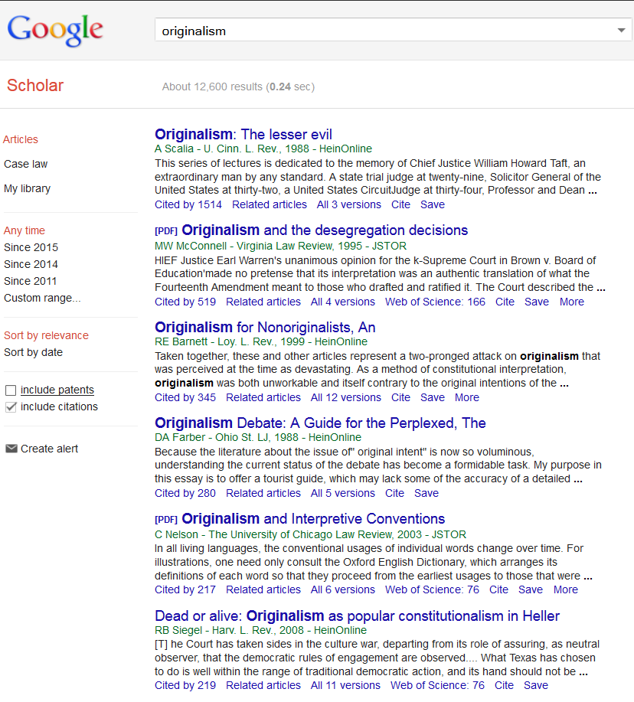
The New Legal Research Paradigm: Google Scholar
Academics rely heavily on Google Scholar.
Typical page break: 6 articles
Researchers (especially students) rarely go past the page break.
Notes:
The use of Google Scholar in academics is substantial.¹
Search engines are preferred to academic search websites, such as the library catalog or Academic Search Complete (or HeinOnline).²
When using Google Scholar, “students rarely investigated or evaluated sources past the first page of results” (83% stayed on the first page).³
“[U]sers do not want to interact with a system beyond entering in a few keywords” and “patterns of use of electronic information systems become habitual.”⁴
When searchers conduct a search in the web, they tend to click on links above to page break; “a sharp drop” in clicking on links occurs after the first page of search results.⁵
Legal research professionals recommend Google Scholar as one of the best free resources.⁶

Slide 5
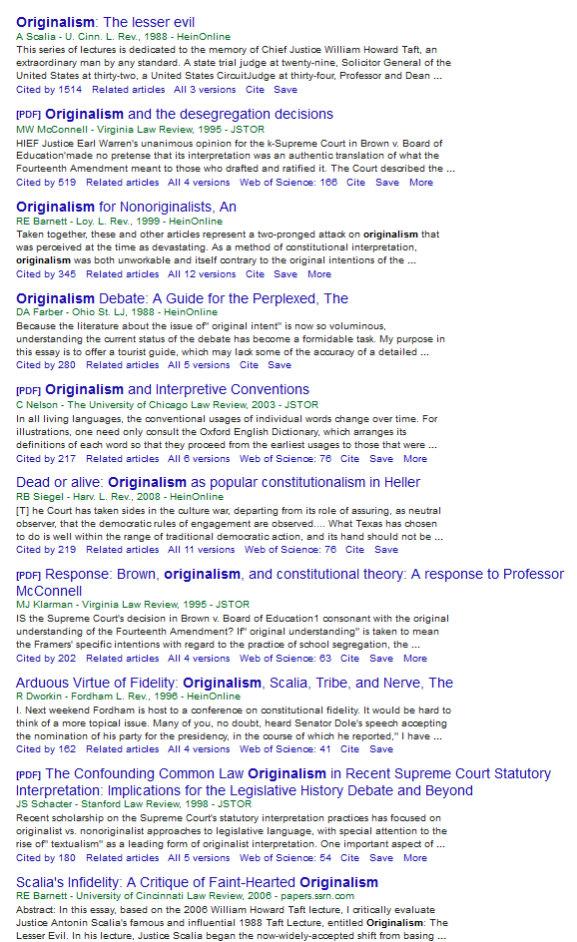
The New Legal Research Paradigm: Google Scholar
Typical first page: 10 articles
Researchers almost never click past the first page of results.
Over time, “patterns of use of electronic information systems become habitual.”
Notes:
The use of Google Scholar in academics is substantial.¹
Search engines are preferred to academic search websites, such as the library catalog or Academic Search Complete (or HeinOnline).²
When using Google Scholar, “students rarely investigated or evaluated sources past the first page of results” (83% stayed on the first page).³
“[U]sers do not want to interact with a system beyond entering in a few keywords” and “patterns of use of electronic information systems become habitual.”⁴
When searchers conduct a search in the web, they tend to click on links above to page break; “a sharp drop” in clicking on links occurs after the first page of search results.⁵
Legal research professionals recommend Google Scholar as one of the best free resources.⁶
----- Meeting Notes (6/18/15 11:14) -----
first: never click past the first page of results -- and this matters beyond Google Scholar because

Slide 6
Adjusting to The New Research Paradigm
Recognize how legal researchers research
Understand the Google Scholar algorithm
Adopt search engine optimization practices
Get on the first page of results
Notes:
In order to adjust, you have to understand how people research, how the Google algorithm works, and how to adopt best practices to optimize results
First, we’ll provide an overview of how we think the Google algorithm works, then introduce you to the best practices we developed.
----- Meeting Notes (6/18/15 11:14) -----
brief introduction to Google algorithm, then more in-deppth discussion of Google Scholar

Slide 7
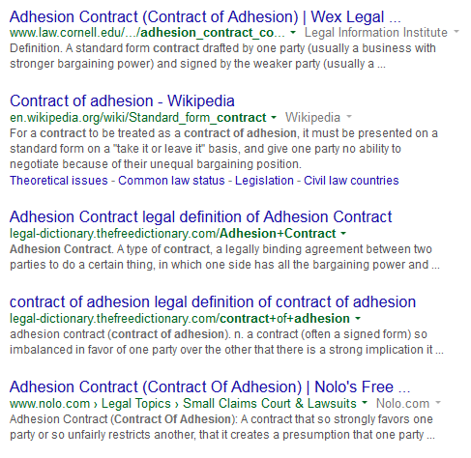
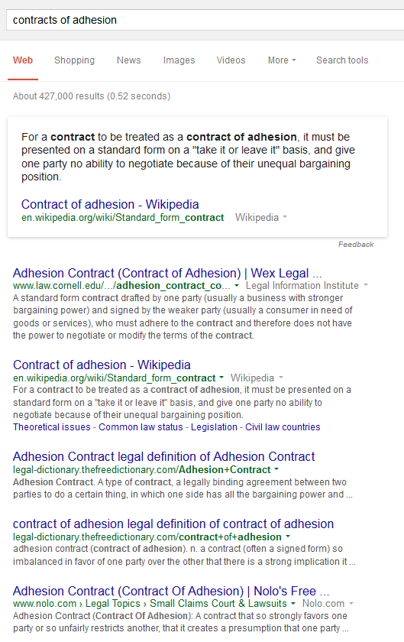
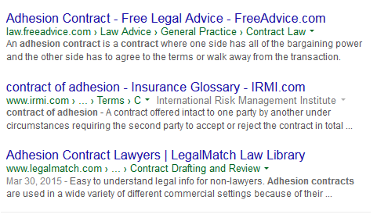
Google Searching
and attorney-referral sites.
Google searches the open web.
Search “contracts of adhesion” ⎯ returns 427,000 results
Top results are from:
online legal dictionaries…
Wikipedia…

Slide 8
Google Searching
Law review articles in Google search results?
Always the first law review article
7th result . . .
1st, 2nd, 3rd result – on the second page of results . . .
Past the page break on the second page
Notes:
Depends on your search history. This article is always the first one to appear. But depending on the computer that you search on, how many times other people have clicked on this result, your own search history, where it appears in the search results varies considerably

Slide 9
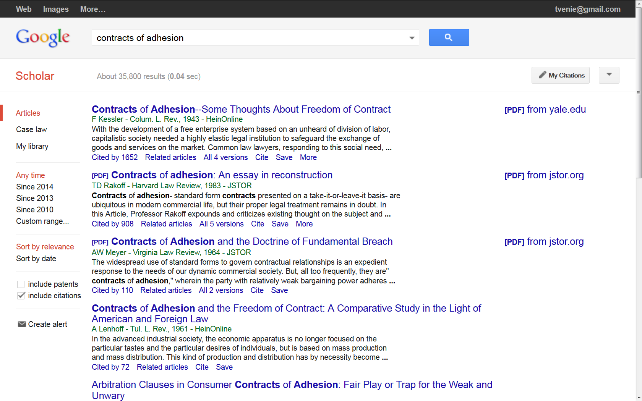
Google Scholar Searching
Only searches “scholarly” sites
Different algorithm than “regular” Google
Results are scholarly articles from academic sources

Slide 10
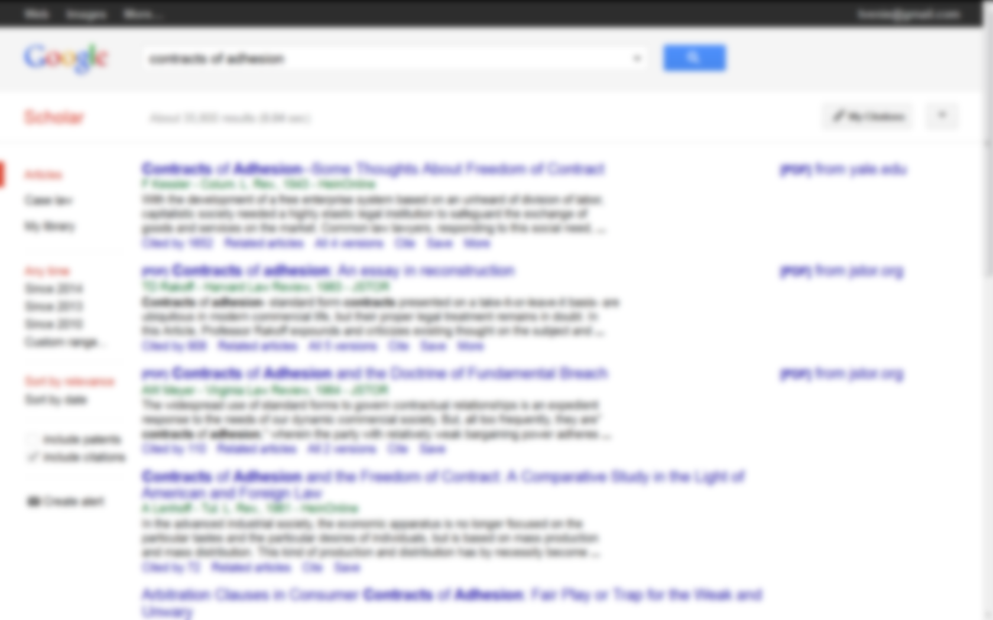
Google Scholar Searching
Notes:
Example: these are the first and fourth results of a Google Scholar search for contracts of adhesion – contracts of adhesion in the title, both are from law reviews though HeinOnline

Slide 11
Google Scholar’s Academic Sources
Searches almost all* major academic publishers and databases, including:
* except Westlaw
Notes:
“Bert van Heerde, a professional in the field of SEO, uses the term ‘invitation based search engine’ to describe Google Scholar: Only articles
from trusted sources and articles that are ‘invited’ (cited) by articles already indexed are included in the database. ‘Trusted sources,’ in this
case, are publishers that cooperate directly with Google Scholar, as well as publishers and Webmasters who have requested that Google Scholar
crawl their databases and Web sites.” From article in footnote 7 of references slide.

Slide 12
Rankings in Google Scholar
Search for “originalism:”
All scholarly articles
“Originalism” in every title
So what determines the rankings?
Notes:
Try a different example: search Google Scholar for originalism – see how search works.

Slide 13
Rankings in Google Scholar
First result:
The title and number of citations contribute to the article’s high ranking.
Notes:
Discuss the fact that the Scalia article is one of the most cited law review articles of all time. Both the number of citations and his prominent name are contributing to its high ranking. Discuss the fact that the Scalia article is one of the most cited law review articles of all time. Both the number of citations and his prominent name are contributing to its high ranking.

Slide 14
Google Scholar Algorithm
We think it’s looking for:
Citation count
Keywords in article titles
Keywords in journal titles
Currency
We don’t think it’s looking for:
Synonyms (in titles or full text)
Keywords in the text

Slide 15
Google Scholar Algorithm
We don’t know if it looks for:
Social media?
Number of citations to other works by the same author?

Slide 16
Best Practices for SEO: The Four C’s of Web Publishing
SEO = search engine optimization
Create attractive titles, abstracts, and metadata
Cross over to other disciplines
Cover multiple web locations
Convert to searchable, machine-readable PDFs

Slide 17
Best Practices 1: Create Attractive Titles . . .
Write catchy titles
accurate
contain keywords
Think about:
Word placement
Using subtitles
Title length – just the essentials
Non-optimized title:
The Right to Be Forgotten*
Optimized suggestion 1:
Online Data Deletion and The Right to Be Forgotten
Optimized suggestion 2:
Maintaining Online Privacy: The Right to Be Forgotten
*by Robert Kirk Walker
Notes:
Cover the essentials, don’t overwhelm the reader

Slide 18
Best Practices 1: Create Attractive Abstracts . . .
Important: appears in “preview” of search results
Focus on:
Keywords
Short, sweet description
Supplements the metadata

Slide 19
Best Practices 1: Create Attractive Metadata
What it is and using it to your advantage
Metadata should have:
Strong keywords
Correct title & consistent name
Accurate disciplines or categories
Institutional affiliation

Slide 20
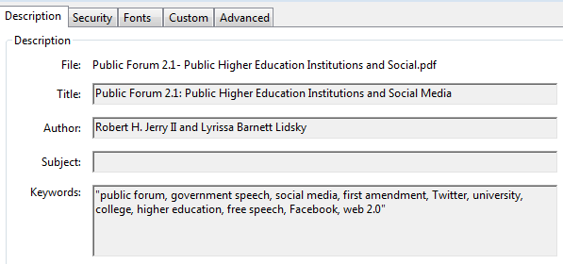
Weak Versus Strong Metadata
Strong Metadata
Article: Public Forum 2.1: Public Higher Education Institutions and Social Media
Authors: Robert H. Jerry II & Lyrissa Barnett Lidsky

Slide 21
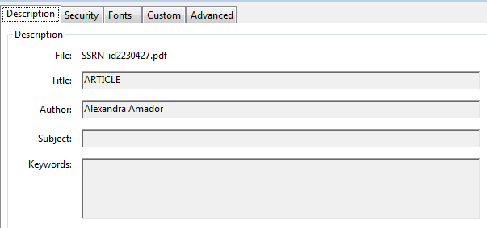
Weak Versus Strong Metadata
Weak Metadata
Article: Public Forum 2.1: Public Higher Education Institutions and Social Media
Authors: Robert H. Jerry II & Lyrissa Barnett Lidsky

Slide 22
Best Practices 2: Cross-Discipline Marketing
Post in sub-disciplines of the broader field
Take advantage of multiple disciplines and subject areas
Use disciplines as keywords
Reach a wider audience
Notes:
E.g., law and economics; law and gender studies
E.g., information technology and libraries;
Most articles touch on different subject areas
E.g., criminal justice; social sciences; library science
Use applicable disciplines as keywords in your abstract and metadata
Expand your influence and reach a wider audience

Slide 23
Best Practices 3: Covering Multiple Web Locations
Post to different websites
Increases unique places an article citation is found or mentioned
Attracts disparate audiences
Catches those who only search specific sites
Notes:
Posting to different websites = greater visibility
May increase scholarship count in Google Scholar

Slide 24
Best Practices 3: Covering Multiple Web Locations
Personal webpage or blog
Faculty webpage
Notes:
Posting to different websites = greater visibility
May increase scholarship count in Google Scholar

Slide 25
Best Practices 4: Convert to Searchable PDFs
OCR = Optical Character Recognition = Machine readable
OCR all documents
Search engines can “read” OCR’d documents
Greater visibility & search engine optimization of your scholarship
Search within your scholarship
Notes:
Make sure your pdf file is compatible on all platforms by selecting which Acrobat version you want
Generally, unless there’s a specific need for backward compatibility, use the most recent version (in this case, Acrobat 9.0 and later). The latest version includes all the newest features and functionality; however, if you’re creating documents that will be distributed widely, consider choosing Acrobat 6.0 or Acrobat 7.0. Using one of these versions ensures that all users can view and print your document.

Slide 26
Getting Buy-in to SEO Practices
Marketing and demonstrations – easy and relevant
Doesn’t decrease bePress or SSRN downloads
Greater visibility & search engine optimization of our scholarship
We want people to find our scholarship
Notes:
Make sure your pdf file is compatible on all platforms by selecting which Acrobat version you want
Generally, unless there’s a specific need for backward compatibility, use the most recent version (in this case, Acrobat 9.0 and later). The latest version includes all the newest features and functionality; however, if you’re creating documents that will be distributed widely, consider choosing Acrobat 6.0 or Acrobat 7.0. Using one of these versions ensures that all users can view and print your document.

Slide 27
Conclusion & Questions
Contact us
Avery Le, averyle@law.ufl.edu
Taryn Marks, tlmarks@law.ufl.edu
Todd Venie, tvenie@law.ufl.edu
Notes:
SSRN and BePress impact on each other and how effects rankings and download statistics – continuation/next step of this presentation

Slide 28
references
Google Scholar Users & User Behaviors: An Exploratory Study, Gail Herrera, July 2010.
J.R. Griffiths and P. Brophy, “Student Searching Behavior and the Web: Use of Academic Resources and Google,” Trends 53, no. 4 (Spring 2005): p. 546.
Paths of Discovery: Comparing the Search Effectiveness of EBSCO Discovery Service, Summon, Google Scholar, and Conventional Library Resources Andrew D. Asher, Lynda M. Duke, and Suzanne Wilson, September 2013 College & Research Libraries vol. 74 no. 5, p. 474.
J.R. Griffiths and P. Brophy, “Student Searching Behavior and the Web: Use of Academic Resources and Google,” Trends 53, no. 4 (Spring 2005): p. 542, 543; Andrews, W. (1996). Search engines gain tools for sifting content on the fly. Web Week, 2 (11), 41–42;
Eye-Tracking Analysis of User Behavior in WWW Search, Laura A. Granka, Thorsten Joachims, Geri Gay, Proceedings of the 27th annual international ACM SIGIR conference on Research and development in information retrieval, 479 (2004).
Making the most of free legal research: a selected annotated bibliography, Ashley Krenelka Chase, Reference Reviews 2014 28:3 , 6-10.
Jöran Beel, Bela Gipp and Erik Wilde, “Academic Search Engine Optimization: Optimizing Scholarly Literature for Google Scholar & Co. ,” 41 Journal Of Scholarly Publishing 176 (2010).
Google Scholar’s Ranking Algorithm: An Introductory Overview, Jöran Beel and Bela Gipp, Proceedings of the 12th International Conference on Scientometrics and Informetrics, 230 (2009).

